Slide 1
Conditional GAN
for
Commonsense Machine Comprehension
王炳宁，刘康，赵军
中国科学院自动化研究所
2017年6月17日

Slide 2

Task Definition
Story Cloze Test
Oliver was nervous about his wedding.
He was worried that he would stutter during the vows.
When the time came, he took a deep breath and began to speak.
He stuttered, but his wife smiled and touched him and he was okay.
Oliver decided to not get married.
Oliver was so grateful for his wife's love.
context
candidates

Slide 3
But …
The training set only contains the positive ending!!!
Billy's car broke down on the highway.
He looked under the hood and realized his starter was broken.
The nearest mechanic quoted Billy 300 dollars, which was far too much.
He instead called a friend who came and fixed the starter for $100.
Billy drove away happily with a functioning engine.

Slide 4
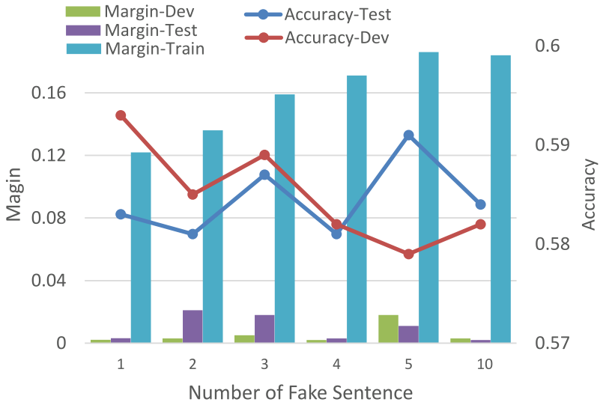
One possible solution
Similar with transXXX, word2vec etc, we can random sample a sentence as the negative candidate
The sentence space is too large to sample!!!!

Slide 5
Our Proposed Solution
Use GANs to generate the negative examples
score
discriminator
fake
true
context
generator

Slide 6








Discriminator
Document GRU
SCORE
$$r_{}^{d}$$
M
$$⊙$$
$$⊙$$
$$⊙$$
$$⊙$$
Attention
$$r_{4}^{s}$$
…
Sentence GRU
$$r_{1}^{s}$$
$$r_{2}^{s}$$
$$r_{3}^{s}$$
…
…
Billy drove away happily with a functioning engine.
…
Billy's car broke down on the highway.
He instead … fixed the starter for $100.
S₀ :
S₃ :
S₄ :
…
Context
Target

Slide 7
Generator
Due to the discrete output of generator (i.e. the one-hot tokens), the gradient of the discriminator could not be properly transformed to the generator.
Some solutions:
Train the generator like an agent in Reinforcement learning paradigm, using the output of the discriminator as the reward¹.
----Very slow when using Monte-carlo search
----The score of the discriminator had a large variance.
Using the softmax output as a approximation to the one-hot representation².
---The softmax output are sometimes not sharp and easily get discriminated by the discriminator
1) Seqgan: Sequence generative adversarial nets with policy gradient-AAAI2017
2) Adversarial Generation of Natural Language-Arxiv2017

Slide 8
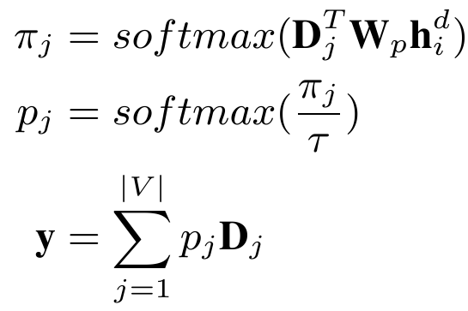


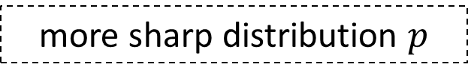



Generator
more sharp distribution $p$
$${ h}_{i}$$
Temperature
$$W_{τ}$$
π
$$W_{p}$$
……
word embedding
$$D$$

Slide 9
Some tricks during training
Pre-training the generator with MLE
Adding small noise to the inputs of the discriminator in each step
Instead of training the generator and discriminator with fixed ratio, we monitor the score of the real and fake example and tuning the training step for D and G thereof.

Slide 10
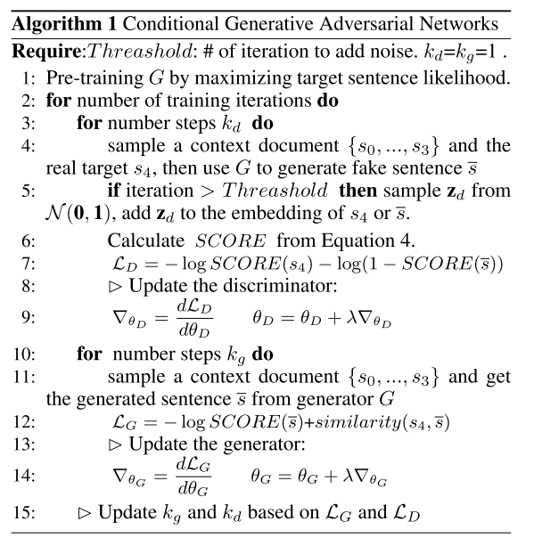
Overall Algotithm

Slide 11
Result
 | Validation set | Test set
Random | 0.514 | 0.513
Frequency | 0.506 | 0.520
N-gram-overlap | 0.477 | 0.494
Gensim | 0.545 | 0.539
Sentiment-Full | 0.489 | 0.492
Sentiment-Last | 0.514 | 0.522
Skip-thoughts | 0.536 | 0.552
Narrative-Chains-Ap | 0.472 | 0.478
Narrative-Chains-Stories | 0.510 | 0.494
DSSM | 0.604 | 0.585
GRU | 0.573 | 0.561
w/o CGAN&Attention | 0.589 | 0.580
w/o Attention | 0.603 | 0.595
w/o CGAN | 0.593 | 0.578
CGAN | 0.625 | 0.609

Slide 12
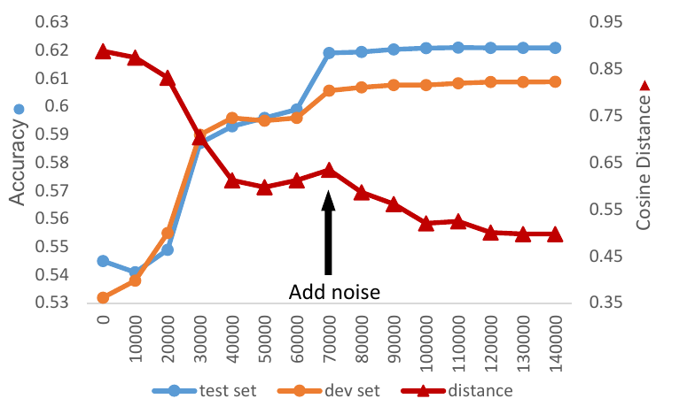
Analysis
The accuracy and cosine distance during training

Slide 13
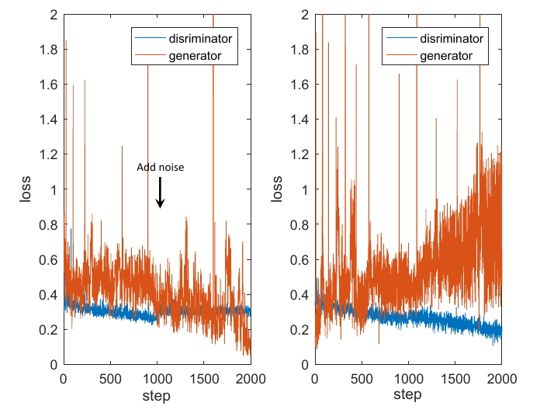
Analysis
The result w.r.t. the noise

Slide 14
The difficulty of Commonsense MC
1) Morgan enjoyed long walks on the beach.
2) She and her boyfriend decided to go for a long walk.
3) After walking for over a mile, something happened.
4) Morgan decided to propose to her boyfriend.
5) Her boyfriend was upset he didn't propose first.

Slide 15
Thank you
Question
&
Answer
research@bingning.wang

