Slide 1


Unsupervised Story Comprehension
with
Hierarchical Encoder-Decoder
Bingning Wang, Kang Liu, Zhixing Tian, Jun Zhao,
Ting Yao, Qi Zhang, Jingfang Xu
NLPR, CASIA & Sogou Inc.

Slide 2

Introduction
Story comprehension (SCT¹)
s
Context
Bob had a young puppy.
The puppy loved to play catch with Bob.
Of course, the puppy grew into a dog.
The dog grew old and could no longer play catch.
Bob was very happy about this.
This made Bob sad.
Candidate Target
1) Mostafazadeh, Nasrin, et al. "A Corpus and Cloze Evaluation for Deeper Understanding of Commonsense Stories." Proceedings of NAACL-HLT. 2016.

Slide 3
Introduction
Bob had a young puppy.
The puppy loved to play catch with Bob.
Of course, the puppy grew into a dog.
The dog grew old and could no longer play catch.
Bob was very happy about this. This made Bob sad.
each story is made up of 5 highly recapitulative sentences
captures a rich set of causal and temporal relations between daily events
Requiring commonsense reasoning

Slide 4
Problem:
The abundant stories are unlabeled containing no negative target sentence
Dakota was a senior in high school with mediocre grades.
Dakota filled out an application to his local college.
He waited for a letter of reply from the college.
One day he went to the mailbox and found a thin envelope.
He opened the envelope and was disappointed he hadn't been accepted.
Maxine usually hates to shave her legs.
She doesn't like the feeling of using a razor.
One night Maxine has a big date and decides to wear a dress.
She shaves her legs for the occasion.
Maxine gets laser removal next time.
……
The absence of the negative example makes the discriminative learning, which is dominant in current machine learning and deep learning systems, impossible.

Slide 5

Traditional Methods:
Script learning:
a type of model that process the temporally ordered sequences of symbolically structured events and try to predict the future events.
plot
Bob had a young puppy.
The puppy loved to play catch with Bob.
Of course, the puppy grew into a dog.
The dog grew old and could no longer play catch.
ending
This made Bob sad.

Slide 6
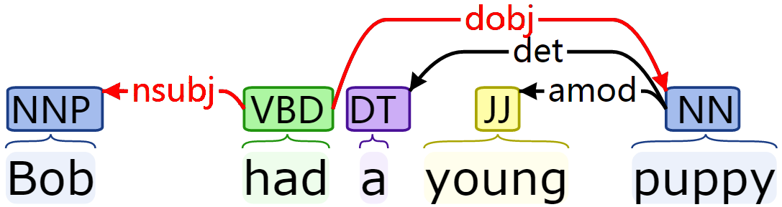
Traditional Methods:
Script learning:
Transform each sentence into triplet with dependency or constituent tree
< Bob , had , puppy >
Bob had a young puppy.
The puppy loved to play catch with Bob.
Of course, the puppy grew into a dog.
The dog grew old and could no longer play catch.
Bob was very happy about this.
This made Bob sad.
<bob,had,puppy>
<puppy,love,play>
<puppy,grow,dog>
<dog,grow,old>
<bob,happy,NULL>
<this,made,sad>

Slide 7
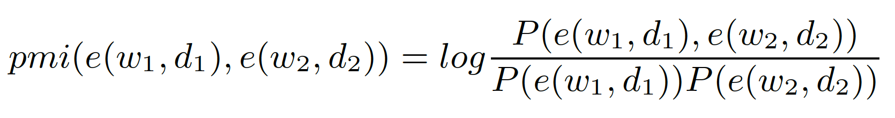
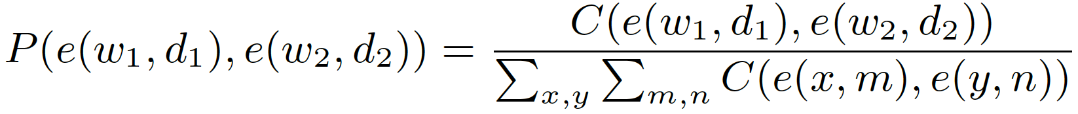
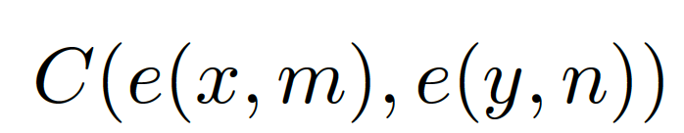
Traditional Methods:
Script learning:
Calculate the point wise mutual information between the context and target triplet.
Where:
number of times the two triplets have coreferring the same entity

Slide 8
Traditional Methods:
Language Model :
Using the unsupervised language model to model the sequence, and then infer the target with smaller perplexity:
Bob had a young puppy. The puppy loved to play catch with Bob. Of course, the puppy grew into a dog. The dog grew old and could no longer play catch. This made Bob sad.
P₁
Bob had a young puppy. The puppy loved to play catch with Bob. Of course, the puppy grew into a dog. The dog grew old and could no longer play catch. Bob was very happy about this.
P₂
P₁>P₂ ?

Slide 9
Traditional Methods:
Sentence similarity
Using methods such as DSSM to determine the similarity.
Bob had a young puppy. The puppy loved to play catch with Bob. Of course, the puppy grew into a dog. The dog grew old and could no longer play catch.
This made Bob sad

Slide 10
Disadvantages of previous methods:
Script learning:
  Rely heavily on off-the-shelf NLP tools
  Brittle and hard to generalization
Language model:
  Do not take the document structure, such as discourse, into account.
  Sometimes biased towards specific target
Sentence Similarity:
  Ignore the inner interaction between context and the target

Slide 11
This work:
We use the encoder-decoder architecture to unsupervised learning the context-target inference
We process the context with a hierarchical model to take the document structure into account
We design a self-controlled loss reweight strategy for training the encoder – decoder.
We employing the abundant external data for transfer learning

Slide 12
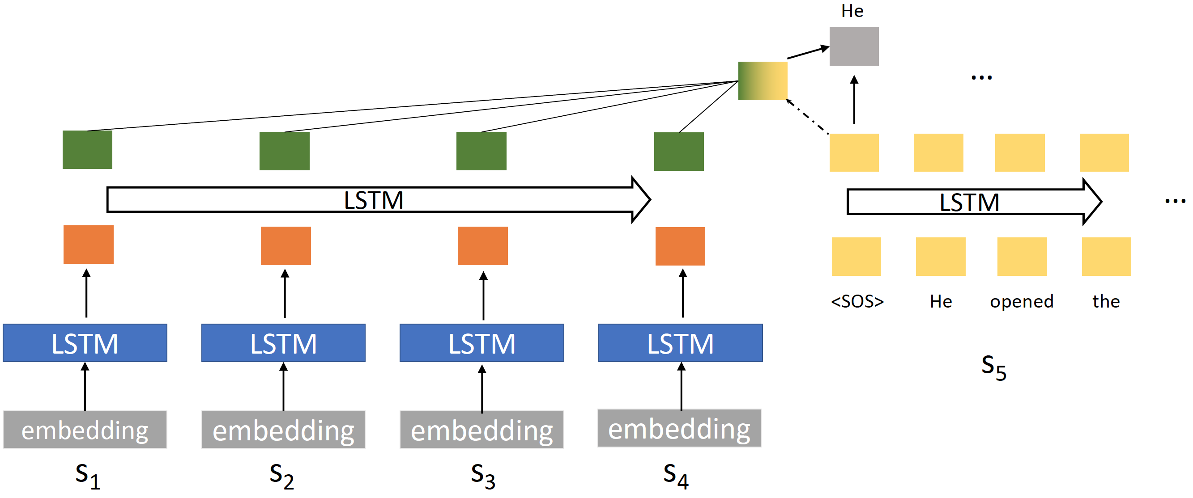
This work:
Architecture
Decoder
Encoder

Slide 13
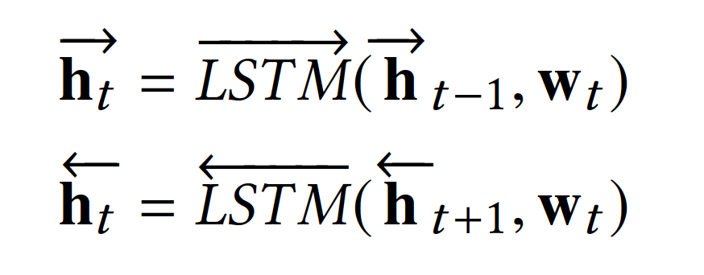
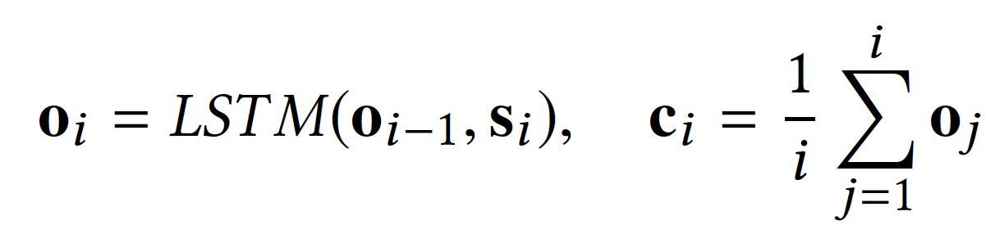
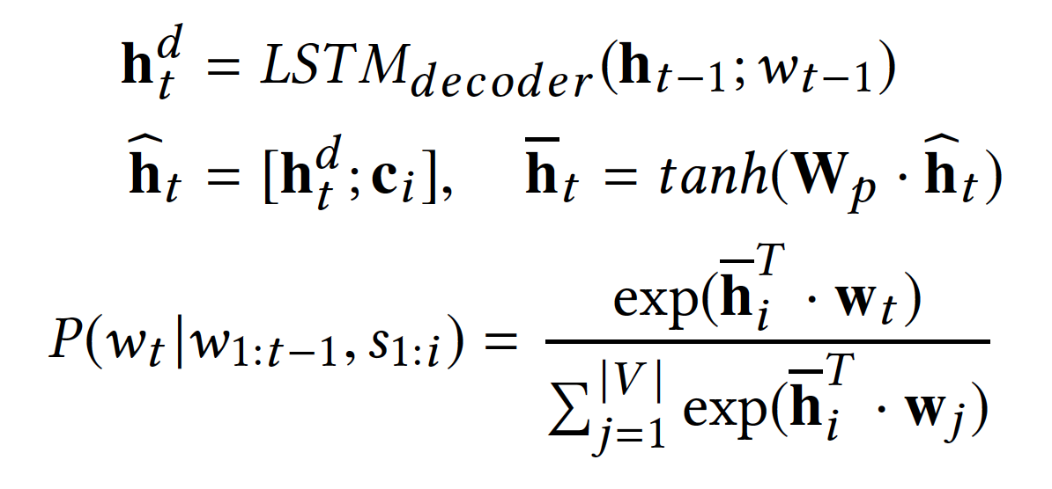
This work:
Sentence Encoder:
Document Encoder:
Output:

Slide 14
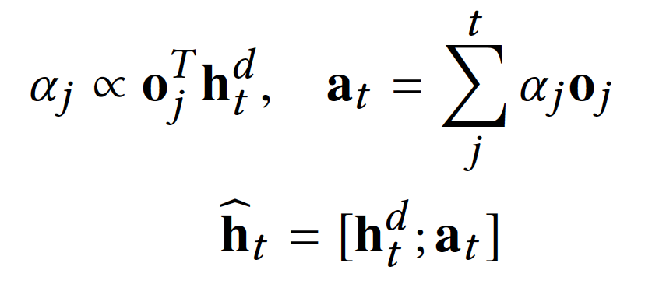
This work:
Sentence Encoder:
Document Encoder:
Output with attention:

Slide 15
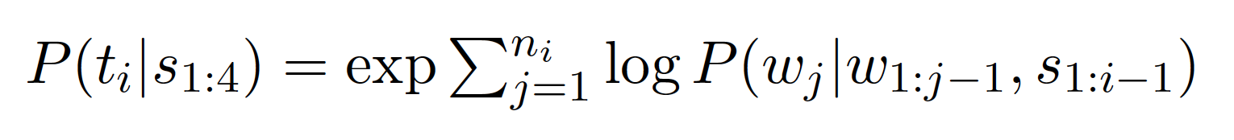
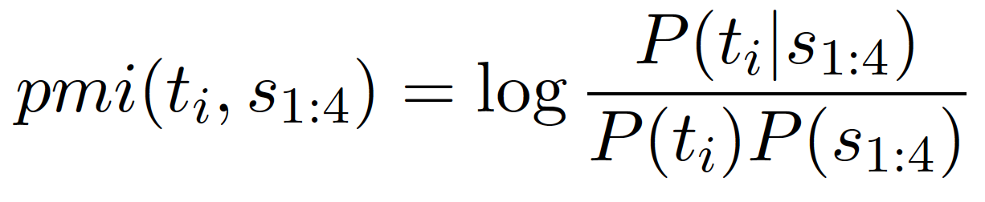
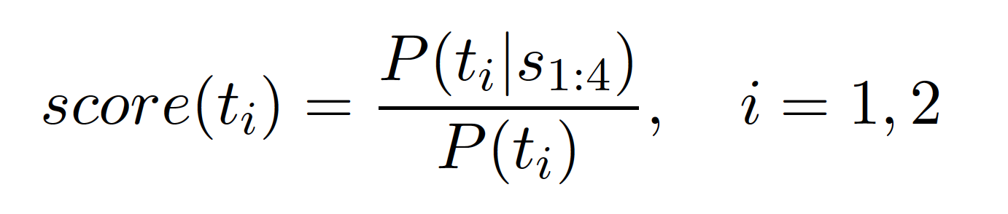
This work:
Inference:
Equal for two candidates

Slide 16
This work:
Loss reweight training strategy:
In encoder-decoder architecture, the information of each timesteps in decoder is not equivalent
Bob was very happy about this </S>
RNN model
<S> Bob was very happy about this.

Slide 17
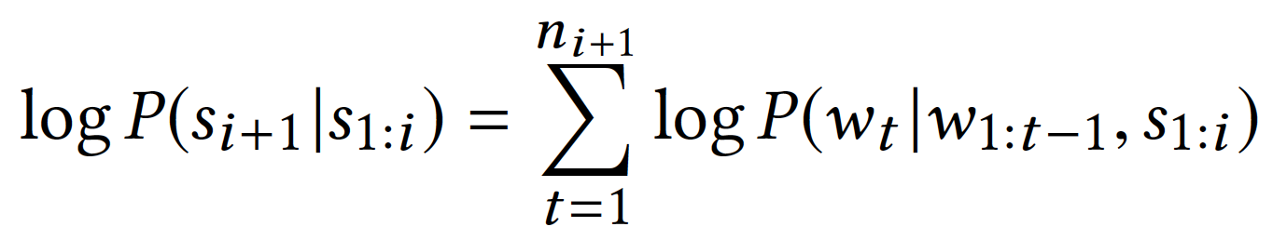
This work:
Loss reweight training strategy:
Maximum likelihood estimation (MLE) training objective for encoder-decoder architecture treat each tokens with equivalent weight:

Slide 18
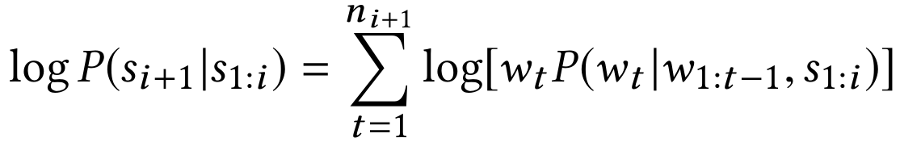
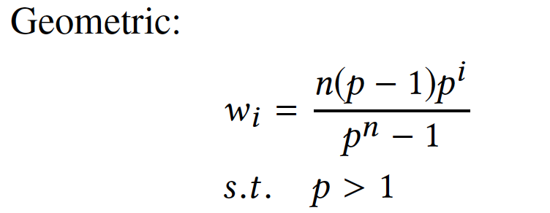
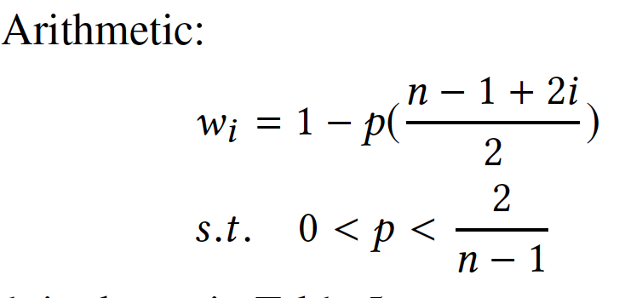
This work:
Loss reweight training strategy:
Dynamically tune each word weight in the final MLE objective:
n: total words
p: hyper-parameter

Slide 19
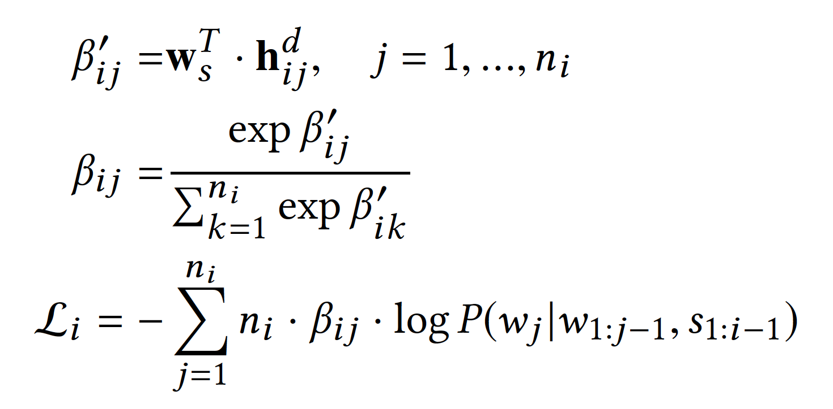
This work:
Loss reweight training strategy:
We learn this weight by the model itself

Slide 20
This work:
Pre-training
Recent works in natural language process reveals the promising result of pretraining, such as BERT, XLNet, GPT-2 …
The proposed architecture could benefit from the abundant unlabeled text.
BookCorpus
  2662 unpublished novels
  16 categories such as Mystery Adventure or Science fiction
  Unformal
Wikipedia
  descriptive
  formal
  High-quality

Slide 21
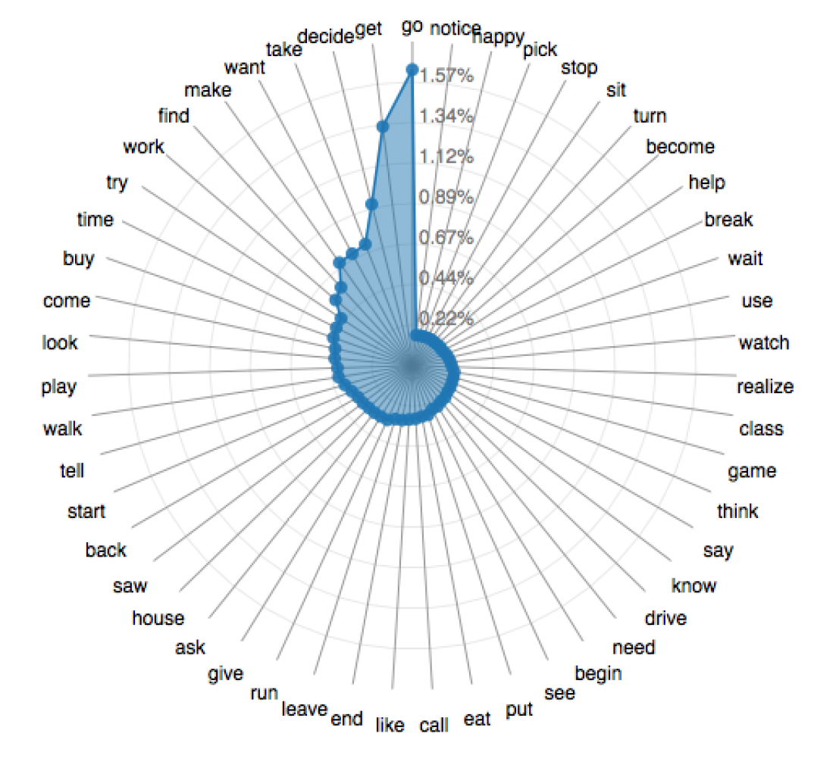
Result
Dataset: story cloze test (SCT)
event distribution
# training data (w/o negative target): ~100k
# dev data (w/ human labeled negative target): 1871
# test data (w/ human labeled negative target): 1871
http://cs.rochester.edu/nlp/rocstories

Slide 22
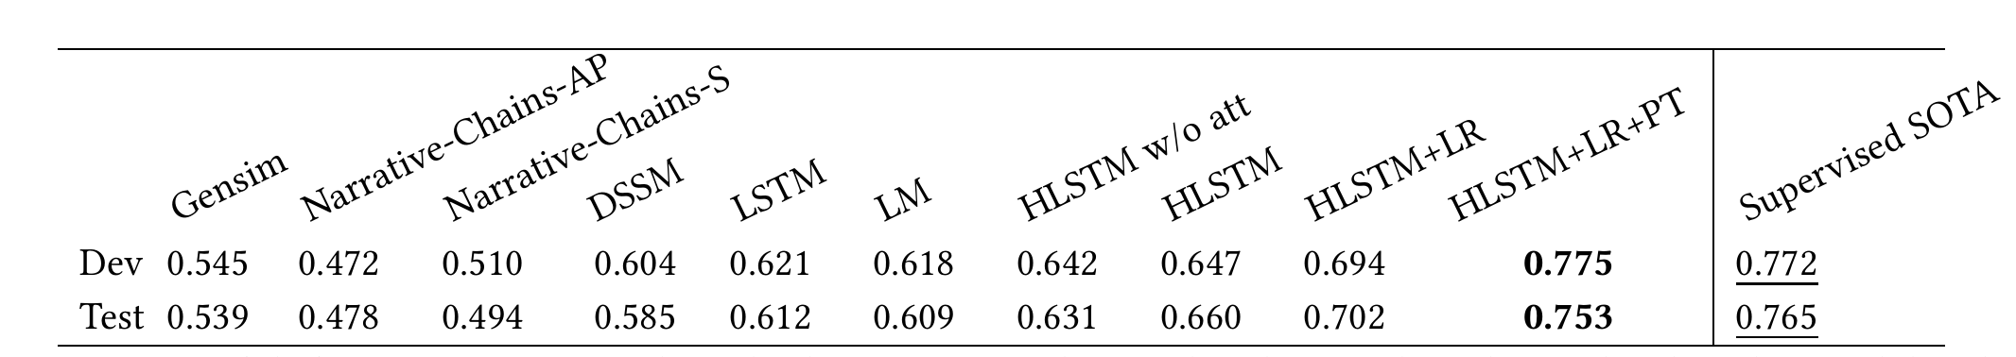
Result
+ loss reweight
+ pre-training
Vanilla model
Supervised method: ignore the abundant training stories and use the scarce dev data to train a classifier.

Slide 23
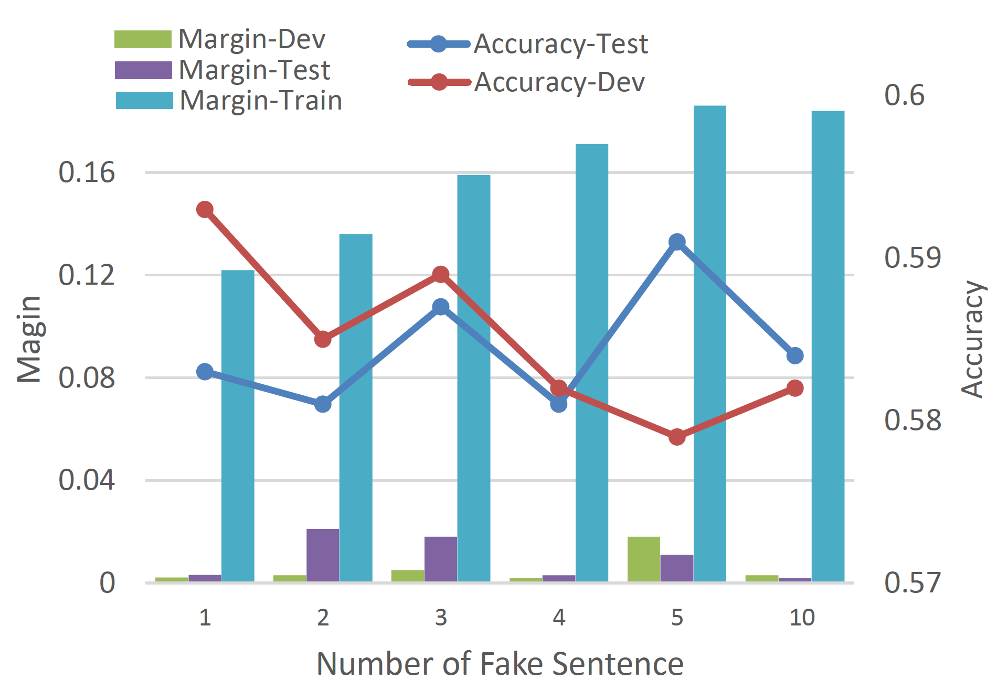
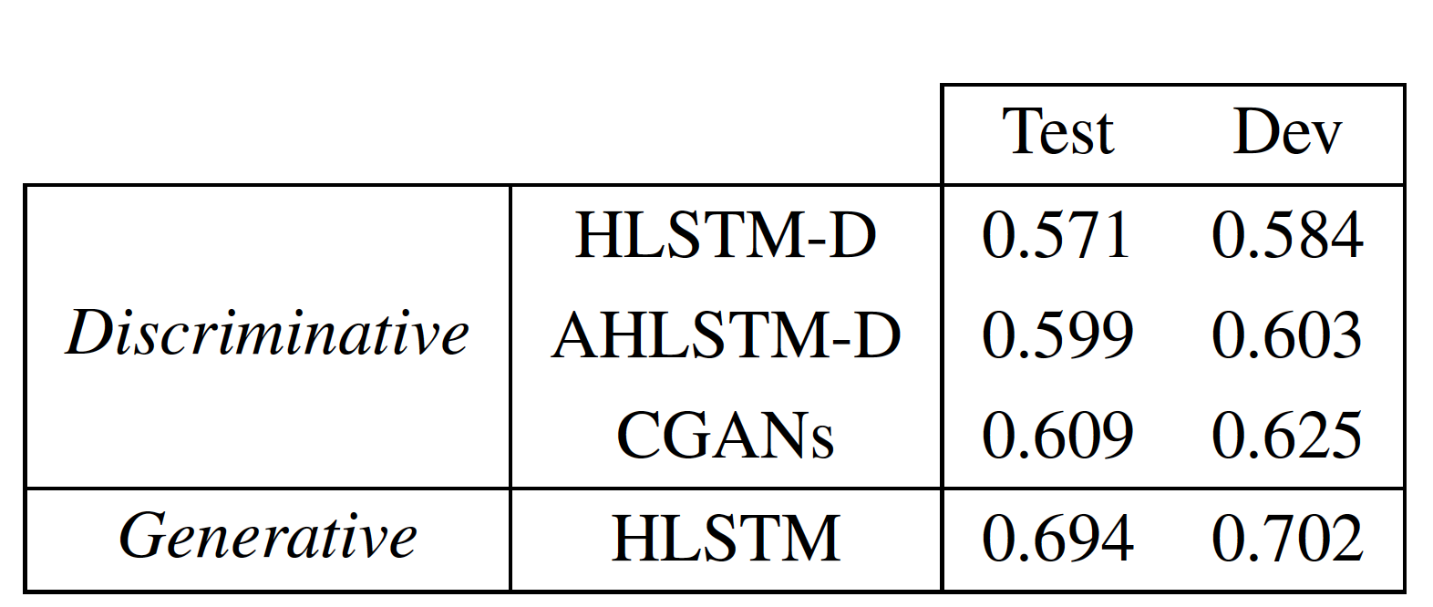
Result
Generative VS. Discriminative
We can also build a discriminative model by random sample a sentence as negative target, and train a classifier based on it .
1
1) The term ‘generative’ is not accord to the generative model in machine learning, but a conceptual reference of models that generate text.

Slide 24
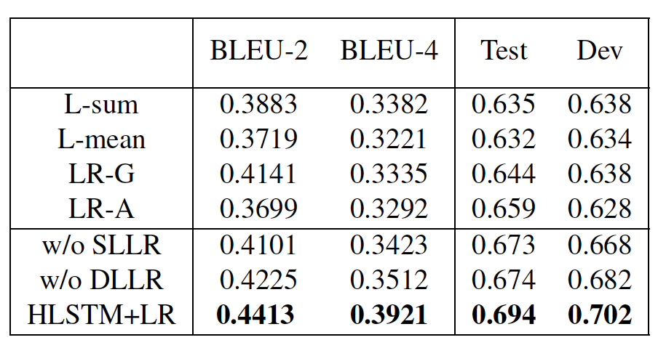
Result
The result of loss reweight:

Slide 25
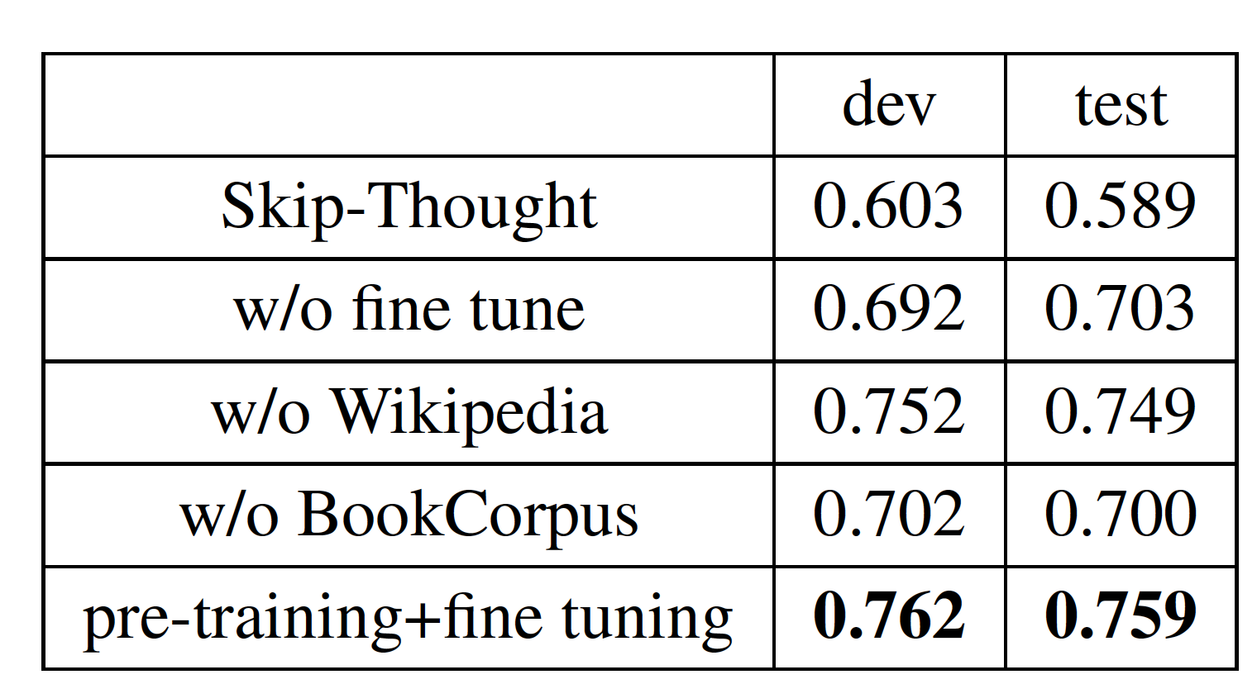
Result
The result of pre-training:

Slide 26
Thank you
wangbiningning@Sogou-inc.com

