Slide 1


Inner Attention based Recurrent Neural Networks for Answer Selection
Bingning Wang, Kang Liu, Jun Zhao
National Laboratory of Pattern Recognition, Institute of Automation, Chinese Academy of Sciences
报告人：王炳宁
2016年6月24日

Slide 2
Attention Bias Problem
In recurrent neural networks, at each time step a word is added and the hidden states are updated recurrently. So these hidden states near the end of the sequence are bound to capture more information than previous states, so the resource is expected to pay more attention to these states.
cosine
r_{q}
r_{a}
ave|max
Attention
SUM
RNN
Question
Answer

Slide 3
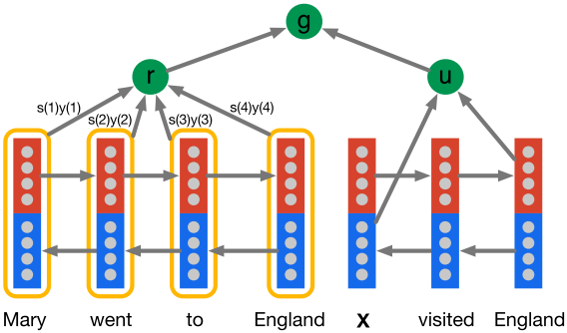
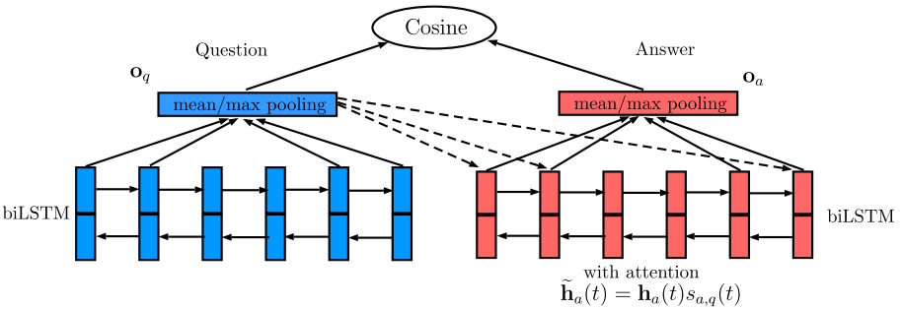
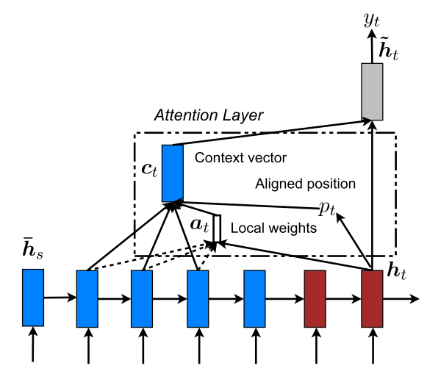
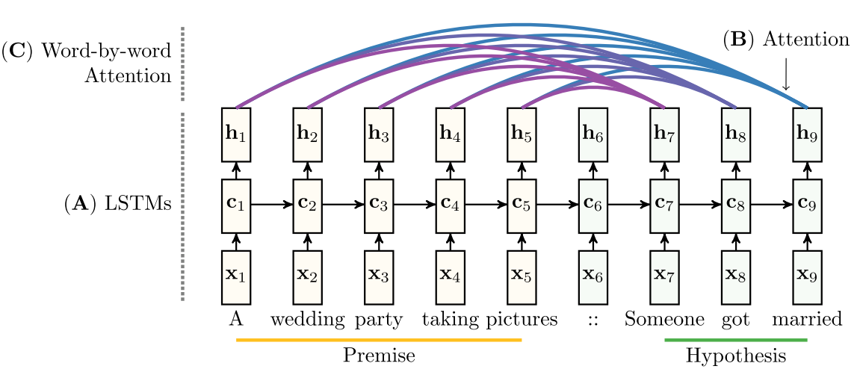
Attention Based Recurrent Neural Networks

Slide 4
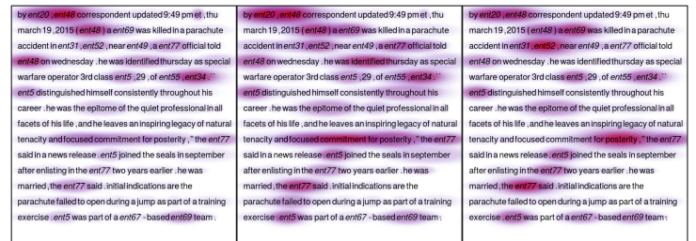
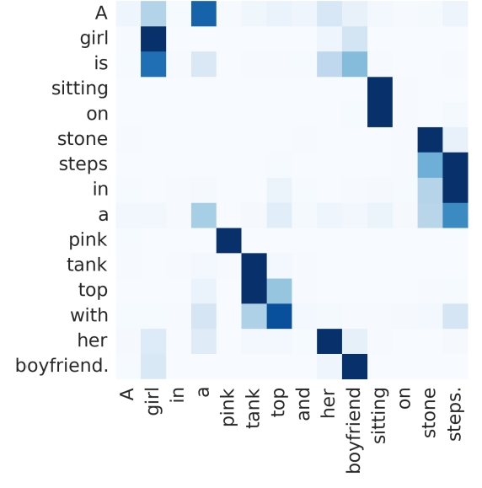
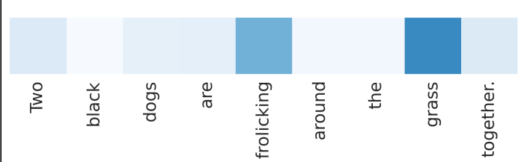
Attention Based Recurrent Neural Networks

Slide 5
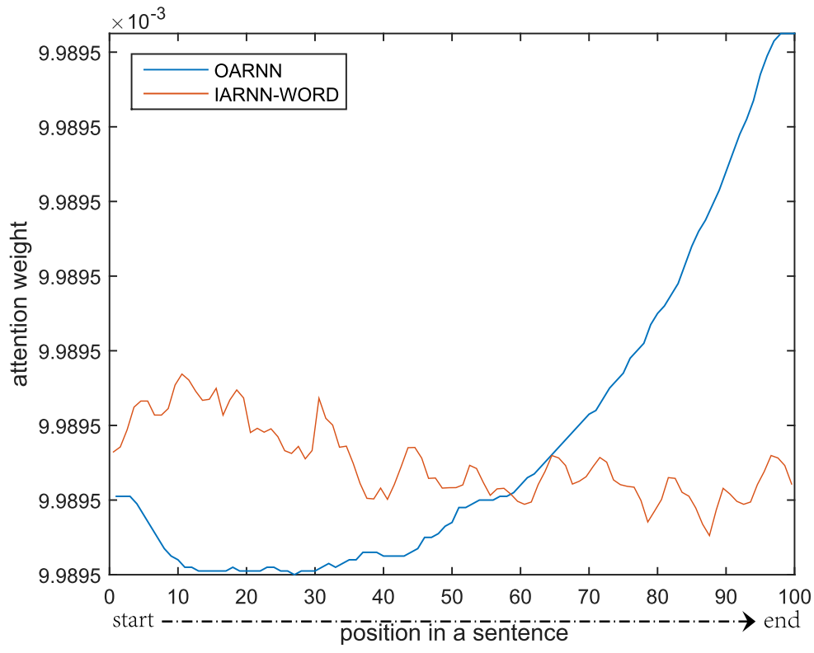
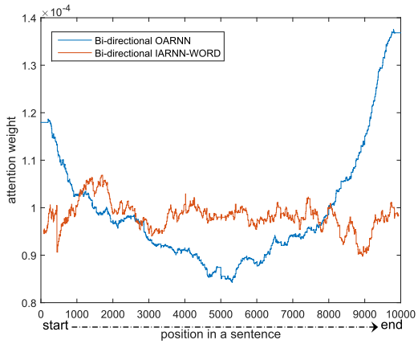
Attention Bias Problem
We analyze this attention bias problem in WikiQA quantitatively.
Attention distribution among the sentence.

Slide 6
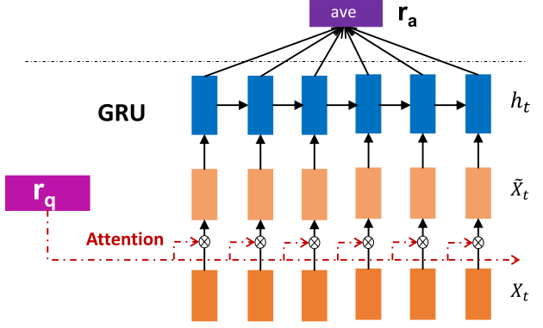
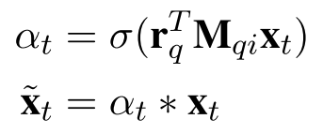
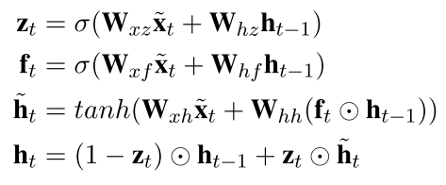
Inner Attention Based RNN models
Model1:
We did not apply attention to the hidden states, but instead a to those original word input embedding.
$r_{q}$ is attention resource ( typically question representation )

Slide 7
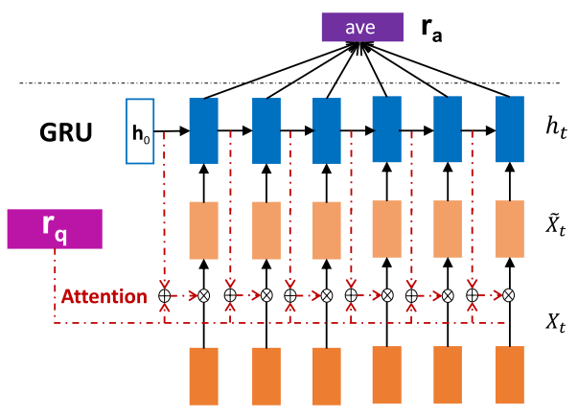
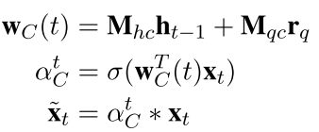
Inner Attention Based RNN models
Model2:
It is a commonplace in natural language that the informed part in a sentence usually spans multiple words.
Hot dog is john’s favorite food.
In addition to the original word embedding, we also add the context states to determine its attention weight.

Slide 8
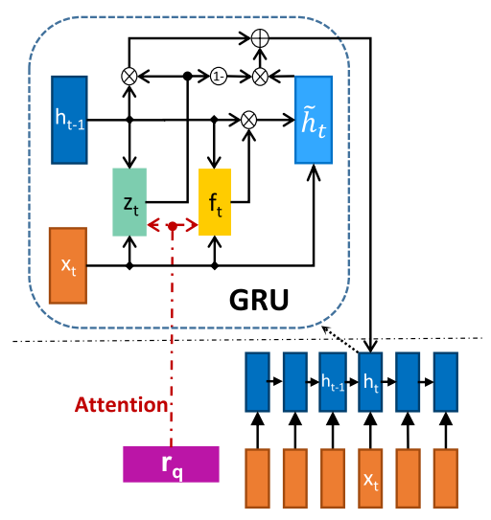
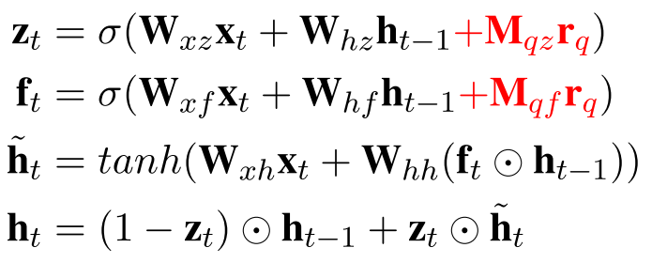
Inner Attention Based RNN models
Model3:
Inspired by previous work on adding gate and memory to the RNN inner activation, we embed the attention information to the hidden state of RNN ( specifically GRU)

Slide 9
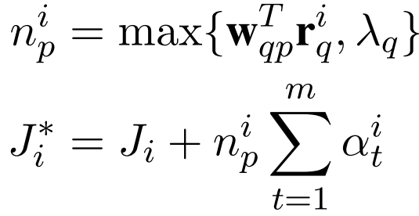
IARNN-Occam
Occam’s Razor : Among the whole words set in the answer, we choose those with fewest number that can represent the sentence respect to the question.
So in this work we add regulation to the summation of the attention weight to impose attention sparsity. However, different type of questions may impose different amount of sparsity to its answers, for example , for the WHY and HOW question it may consist of many words in the answer that are informative, in contrast, the WHO or WHERE types questions may only consists of little words that should be attend.

Slide 10
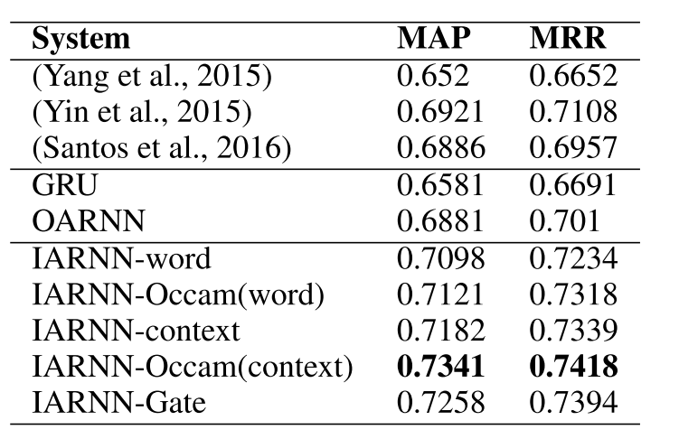
Experiment and Result
Performance on WikiQA

Slide 11
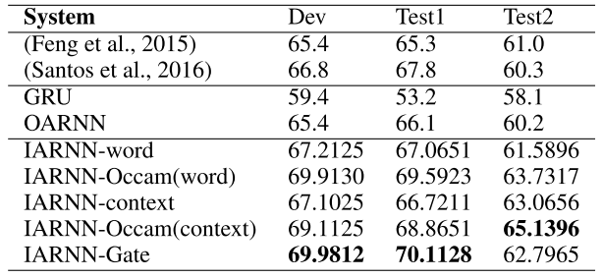
Experiment and Result
Performance on InsuranceQA

Slide 12
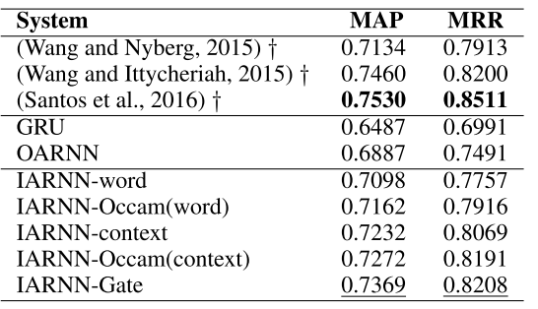
Experiment and Result
Performance on TrecQA

Slide 13
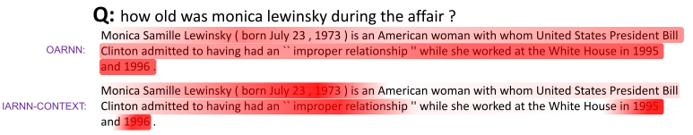
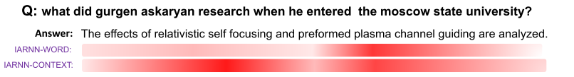
Experiment and Result

Slide 14
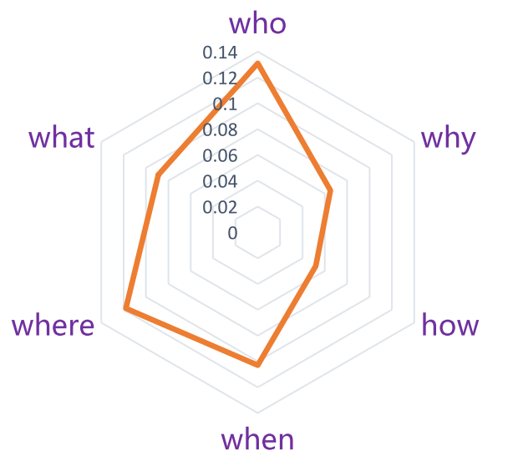
Experiment and Result

Slide 15
Thank you
research@bingning.wang

